Slide 1
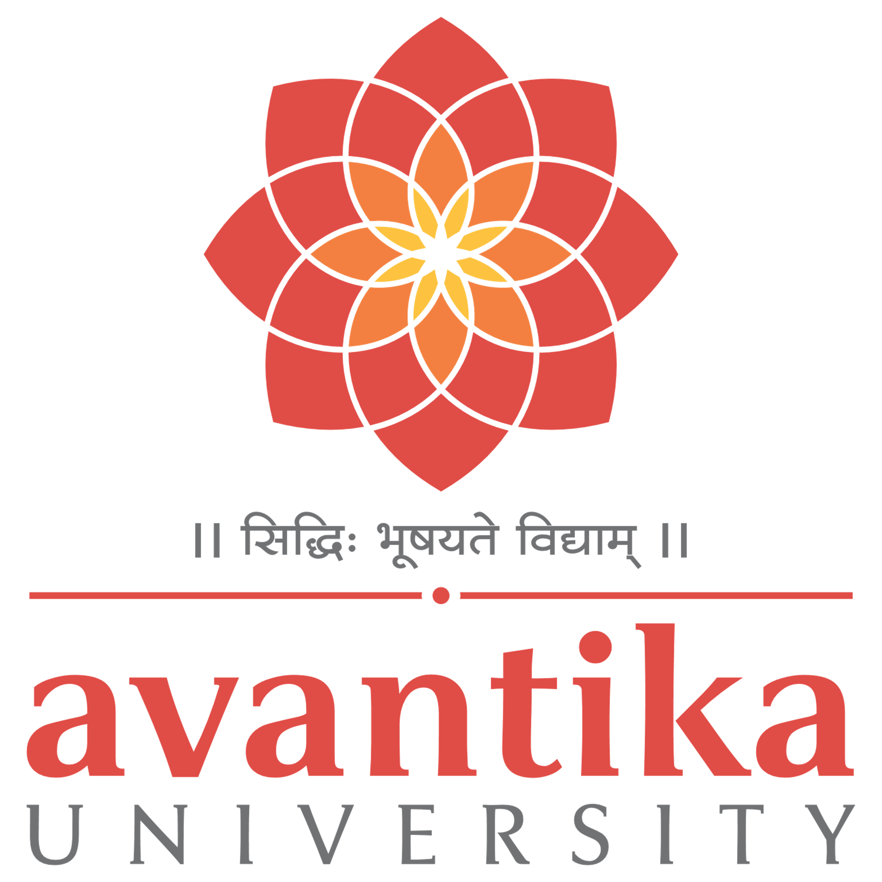
BBA 3rd SEM 2023-24 Strategic Management
Submitted By -
Shankh Bansal
Submitted To -
Dr. Harish Bapat

Slide 2

Founded in 1946, is a dairy operative movement in India..
A brand name managed by Gujrat corporative milk marketing federations.
Jointly owned by 2.6 million milk producers in Gujarat.
Spurred the white revolution of India, which has made India the largest producer of milk and milk product in the world.
Overseas market Mauritius, UAE, USA, Bangladesh, Australia.
﻿﻿Dr. Varghese Kurien former chairman of GCMMF is the man behind the success of Amul
﻿﻿The brand name Amul, sourced from the Sanskrit word Amoolya, means priceless.

Slide 3
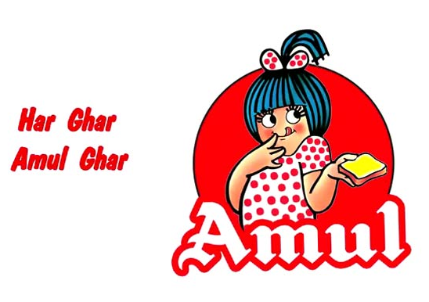
Vision
“Amul's vision is to provide more and more satisfaction to the farmers, their customers, employees and distributors.

Slide 4
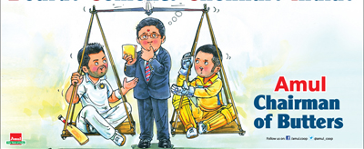
Mission
"To satisfy the taste and nutritional requirements of the customers of the world and committed to offering quality products that provide the best value for money"

Slide 5
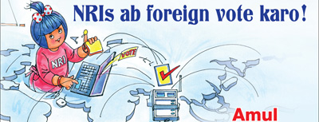
Values
﻿Value for many.
Value for money.
﻿﻿Give customers a good, fair deal. Great customer relationships take time. Do not try to maximize short term profits at the expense of the building those enduring relationships.

Slide 6
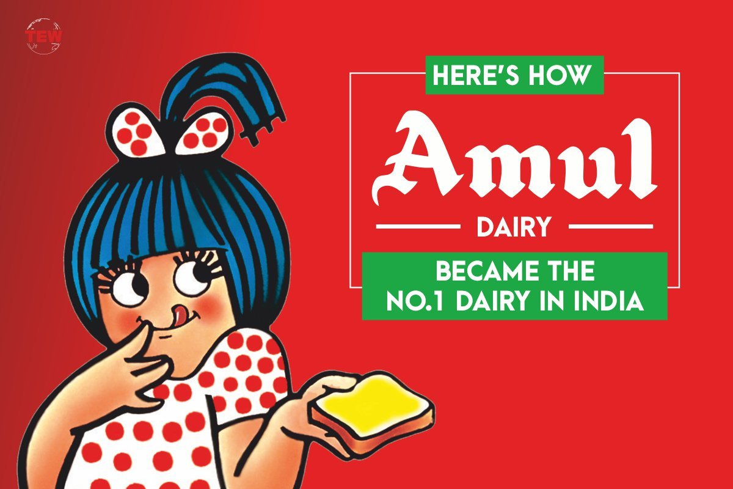
Goals
Amul aims to provide remunerative returns to the farmers and also serve the interest of consumers by providing quality products which are good value for money.

Slide 7

Objective
The objective of Amul, the dairy cooperative in India, is to spur the White Revolution in the country and make India the largest producer of milk and milk products in the world. The cooperative is shared between over 2.8 million dairy producers and the three-tier Amul Model has increased India's milk production on an incredible scale.

Slide 8
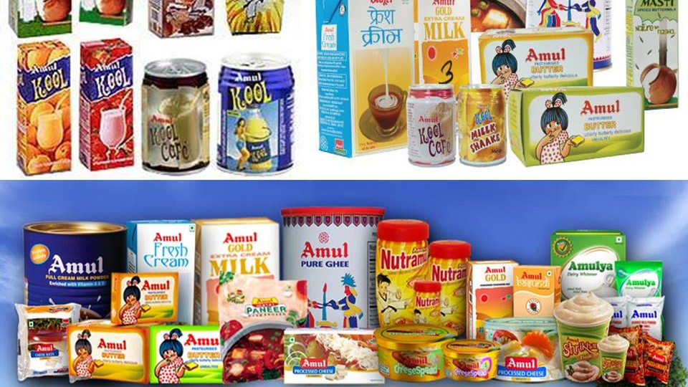
SBU's

Slide 9
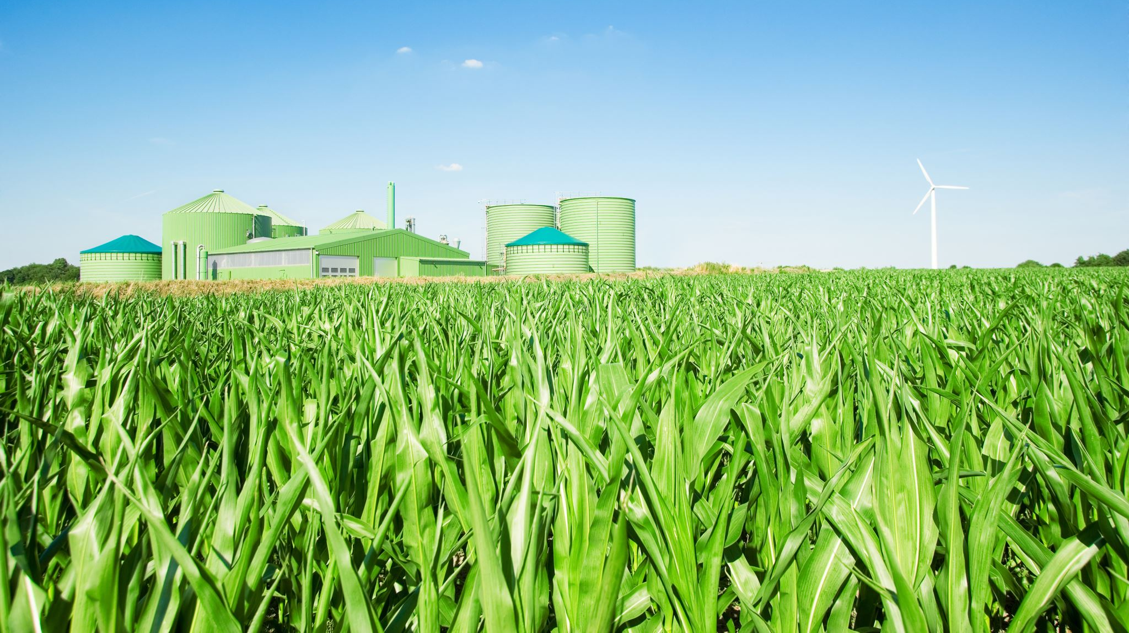
Business Model
Amul works in a three-tiered structure. In every village, the Village Dairy Cooperative Society is formed, where the Milk producers are a member of the Village Dairy Cooperative Society, which elect their representatives. These representatives manage District Milk Unions, which takes care of the Milk and its products and manages its packaging and processing. These products are sold to the State Milk Federation, which acts as the distributed and sells the products in the market. Farmer organizations directly sell products to consumers through the state milk federation. The intermediaries are eliminated which provides good income to the farmers.

Slide 10

Competitors
Kwality Walls
Arun Ice-creams
Havmor
Mother Dairy
Britannia Industries
Nestle Ltd
Baskin Robbins
Local Dairies

Slide 11
Customer based market segmentation
Kids - Youth Amul Kool, Chocolate, Milk Nutramul Energy Drink, Amul Kool Millk.
Women - Amul Calci +
Youth - Utterly Delicious Pizza, Amul Pizza Cheese, Amul Cheese Spread
Calorie Conscious - Amul Lite, Sagar Skimmed Milk Powder, Amul Lite Slim and Trim Milk
Health Conscious - Nutramax, Amul Shakti, Health Food Drink

Slide 12
Industry-based market segmentation
Milk – Restaurants, food chains, ice-cream manufacturers, coffee chain store.
Butter/cheese/ghee - Bakery, pizza chains, snack retailers.

Slide 13

Reason for success
Robust supply chain.
Low cost strategy.
Diverse product Mix.
Strong distribution network.
Technology & e initiatives.

Slide 14
The competitive advantage of Amul
Market leaders
Strong product portfolio
Well-established supply chain.
Huge customer base.
Low advertisement cost.

Slide 15
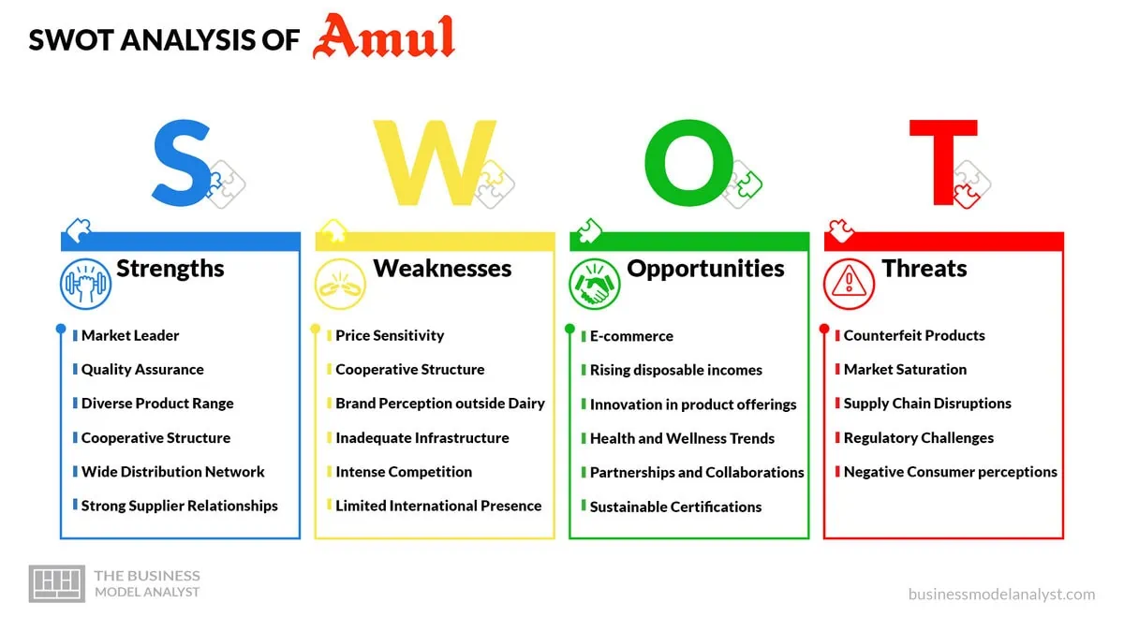

Slide 16
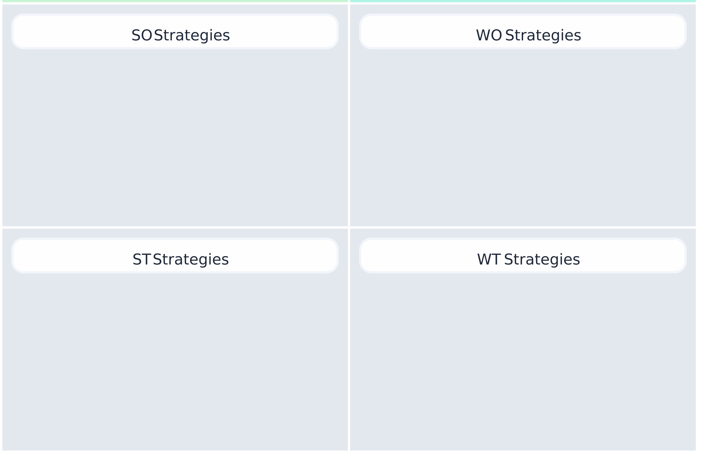
TOWS
Increase productivity by using cost-effective manufacturing techniques.
Increase demand for their products world over by first gaining more exposure to the global market.
Develop new processes to improve the quality and shelf life of milk and milk products, this can be achieved through pasteurization, homogenization and many other processes like producing UHT milk etc.
Product differentiation is very important to differentiate Amul from its competitors.
To have control over the logistics and to maintain them efficiently. Lastly, create the right type of product positioning for the various product categories that Amul deals with.

Slide 17
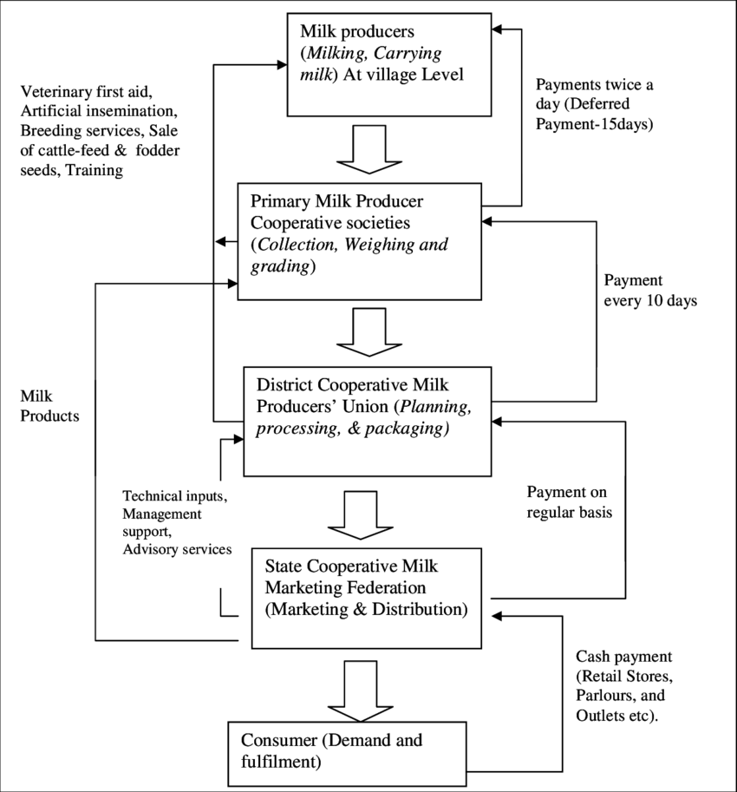
Amul distribution

Slide 18
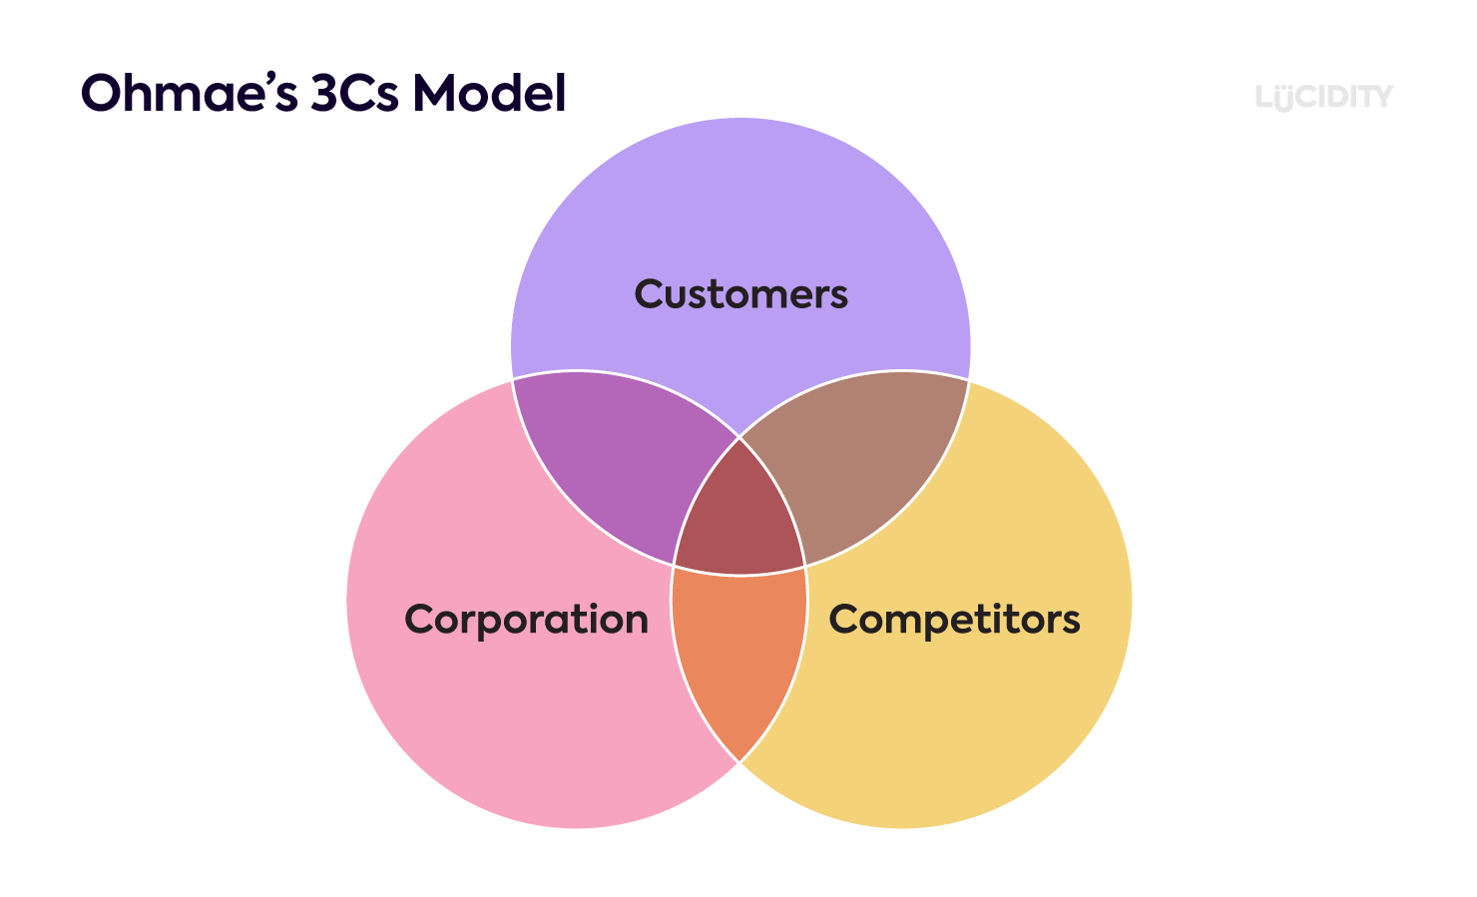
Customers extremely satisfied
Moved from loose milk to Packaged milk Ready to try more products.
Improved socio-economic conditions
Defending against Mahananda, Vijay, Milma & other co-operative milk brands
Aggressive moves against Britannia, Nestle, Mother Dairy.
Largest milk brand in Asia
More than 30 dairy brands
Market leader in ghee & butter Very strong supply chain.
Enjoys Fine reputation
Quality with Affordability

Slide 19
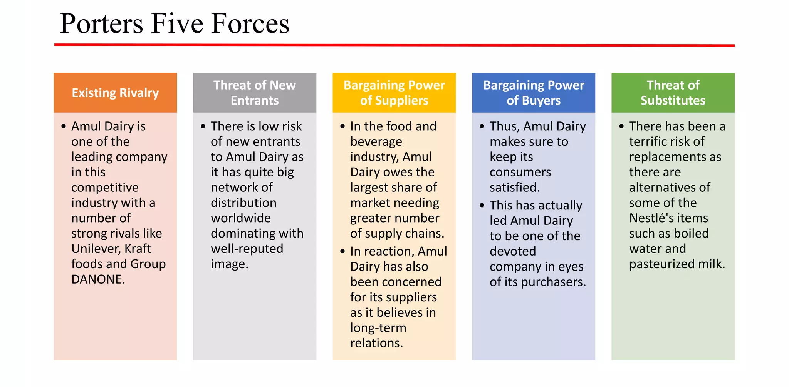

Slide 20
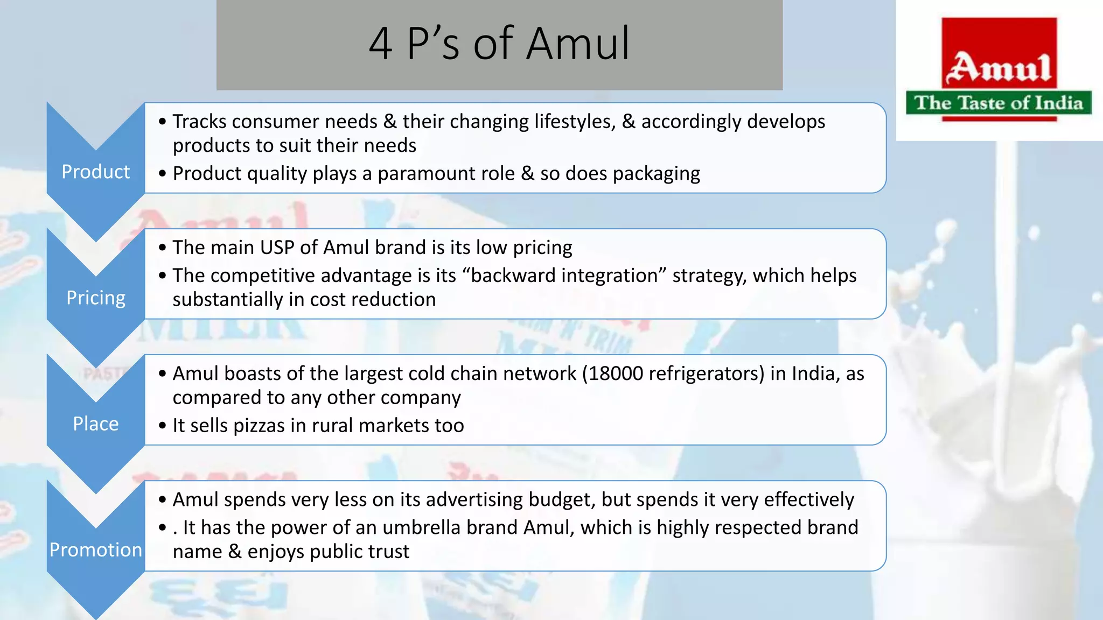

Slide 21
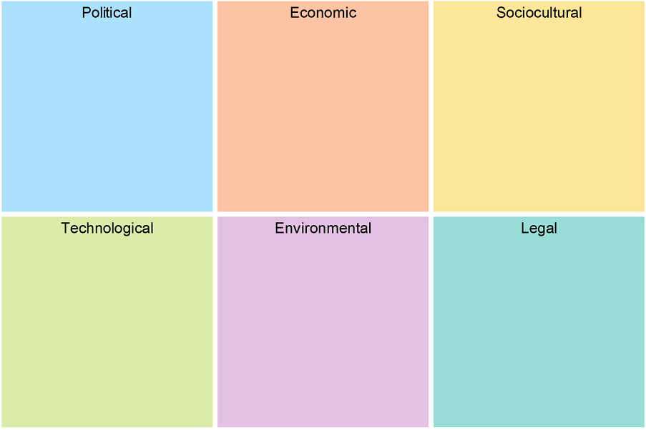
P
E
S
T
E
L
﻿100% FDI allowed ﻿﻿﻿Export restrictions Milk powder was banned for exports in 2012. ﻿﻿﻿
Cut in import duties of milk and milk products ﻿Declining of dairy sector 1991.
NDDB gives loan at 0% interest rate and also development grants at lower interest rates.
﻿﻿﻿India high GDP growth rate implies increase in per capita income of people and thus more consumption of food item.
﻿Lifestyle- Fast food culture carters more demand for ice-cream, cheese etc. ﻿﻿﻿
Culture- Custom of morning tea, more accustomed to milk and milk products
Automation process, technology HACCP & ISO TOM
Net enabled kiosks
﻿E commerce GIS
﻿﻿﻿Innovation in cold chain technology
﻿﻿﻿National Dairy research institute.
Focus & Spending on Renewable Technologies
Influence and Effectiveness of Environmental Agencies
Waste Management
Influence of Climate Change.
Adherence to Common Law
Data Protection Laws
consumer Protection Laws

Slide 22
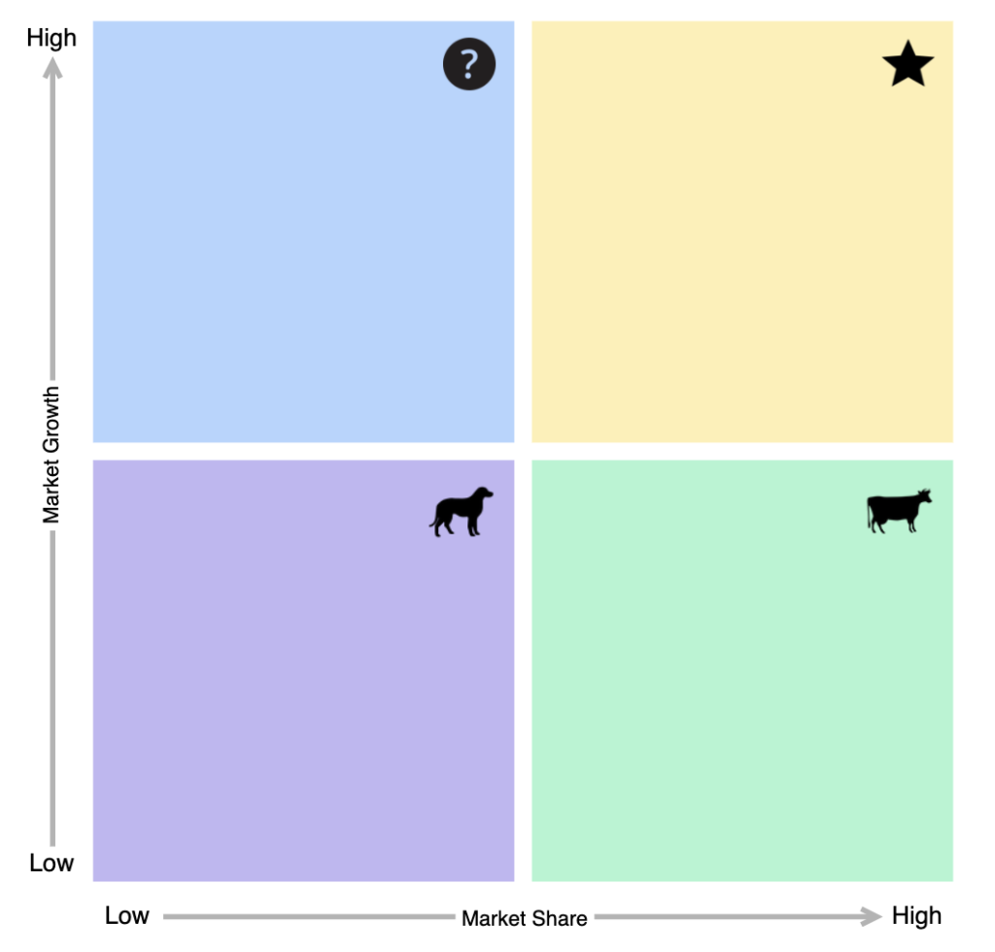
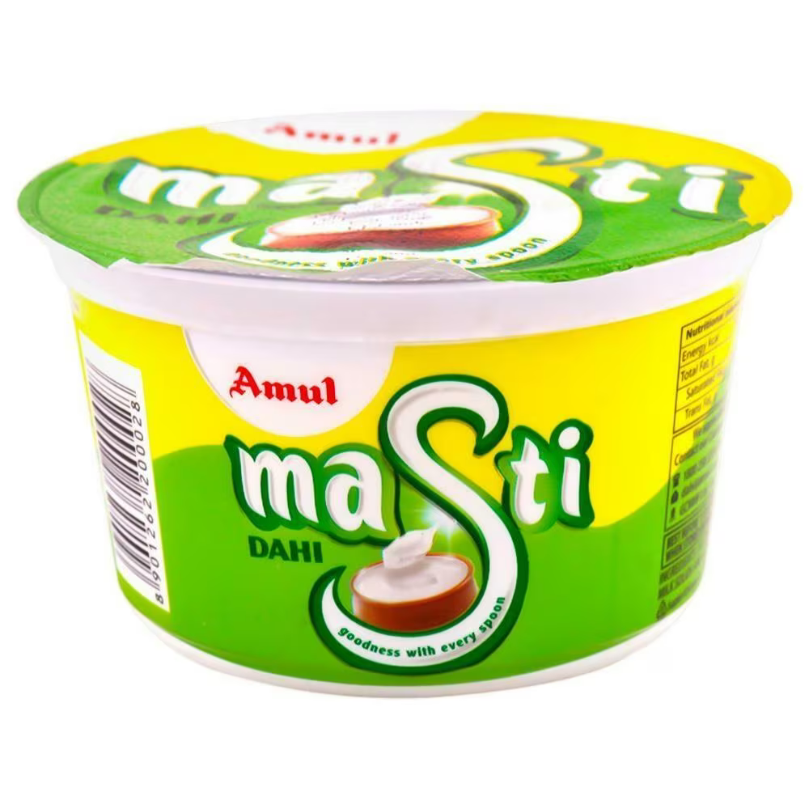
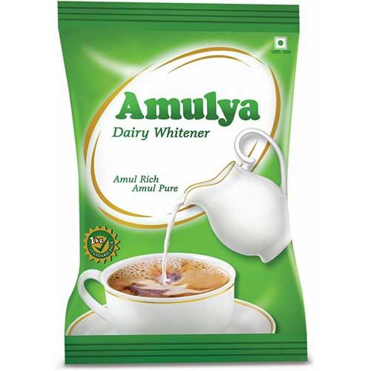
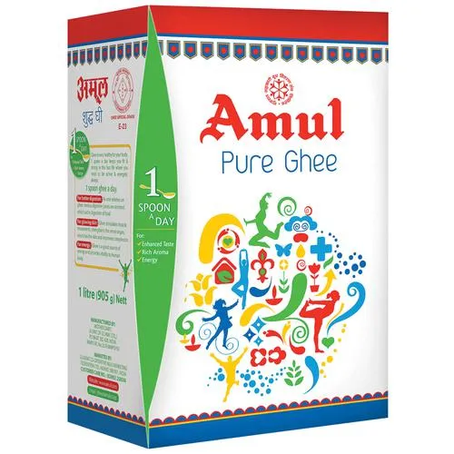
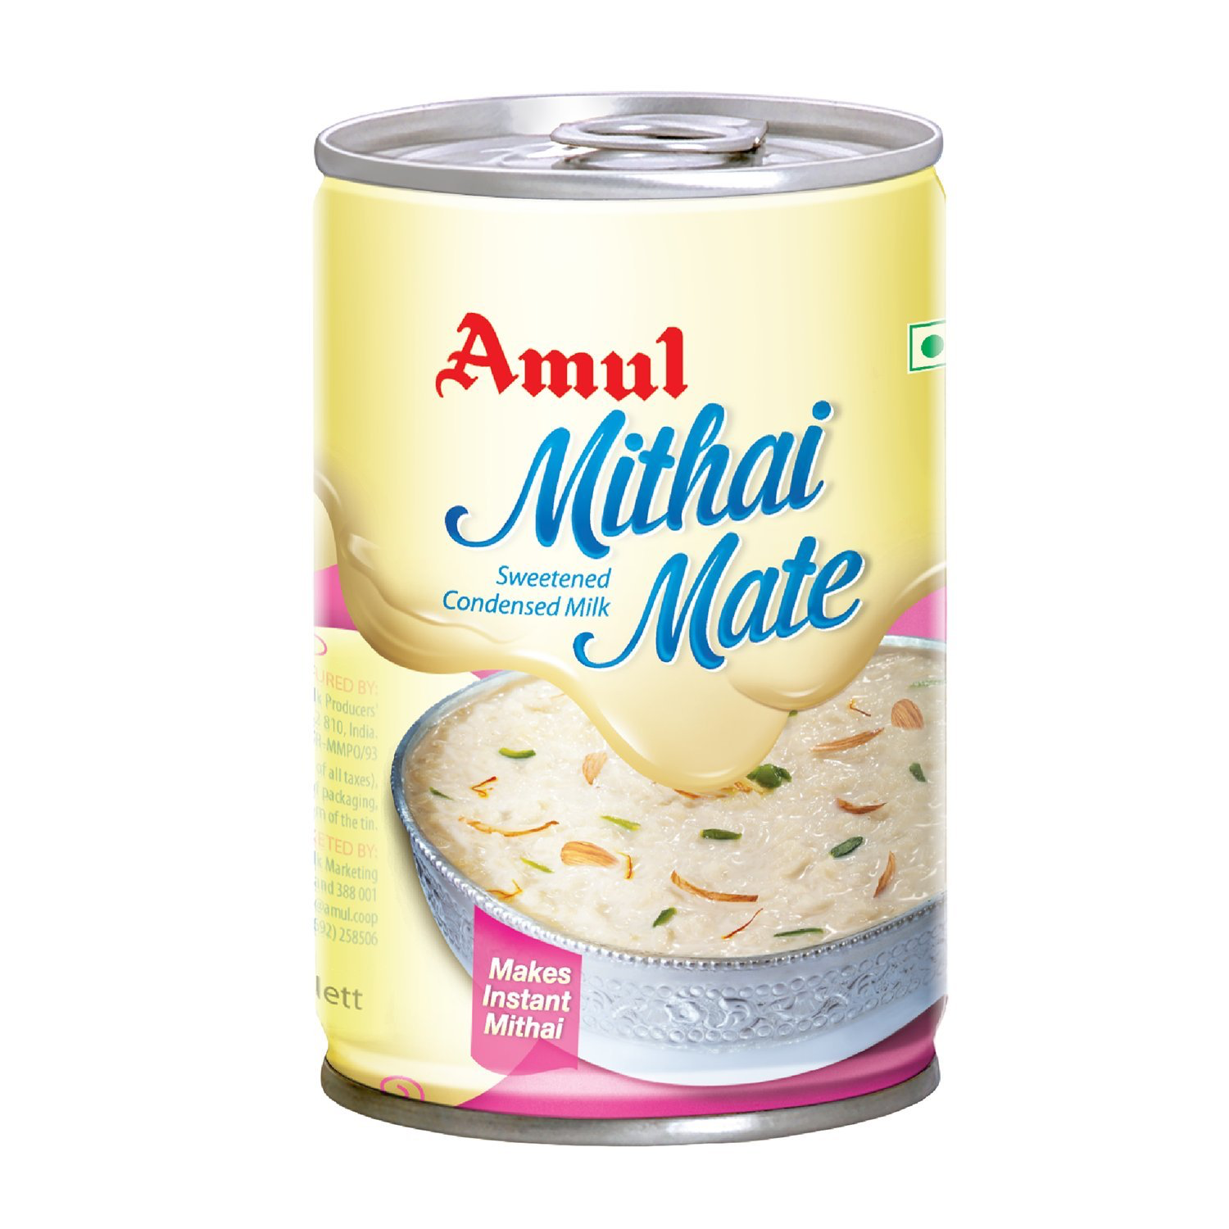
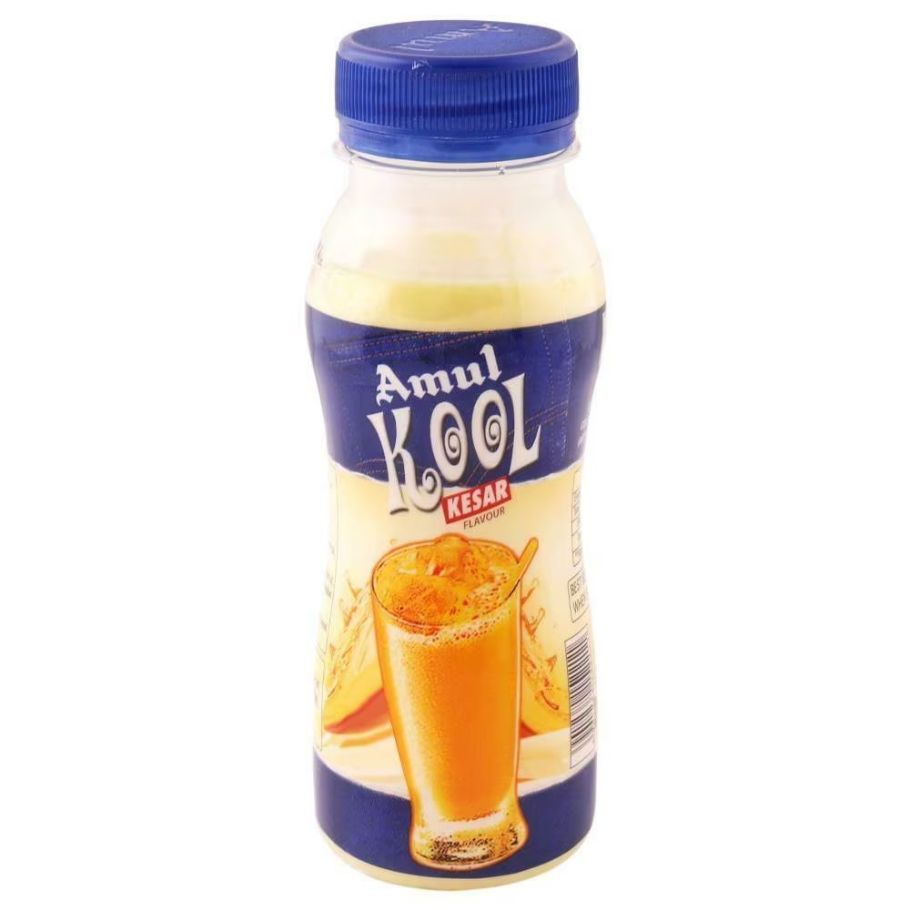
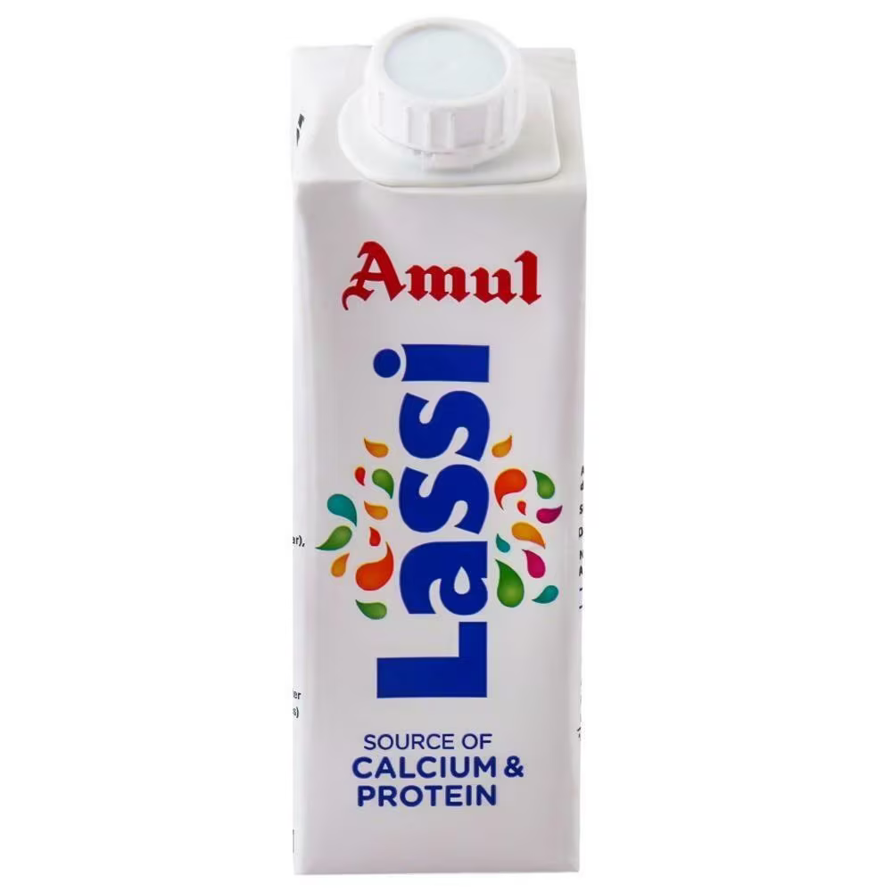
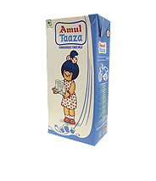
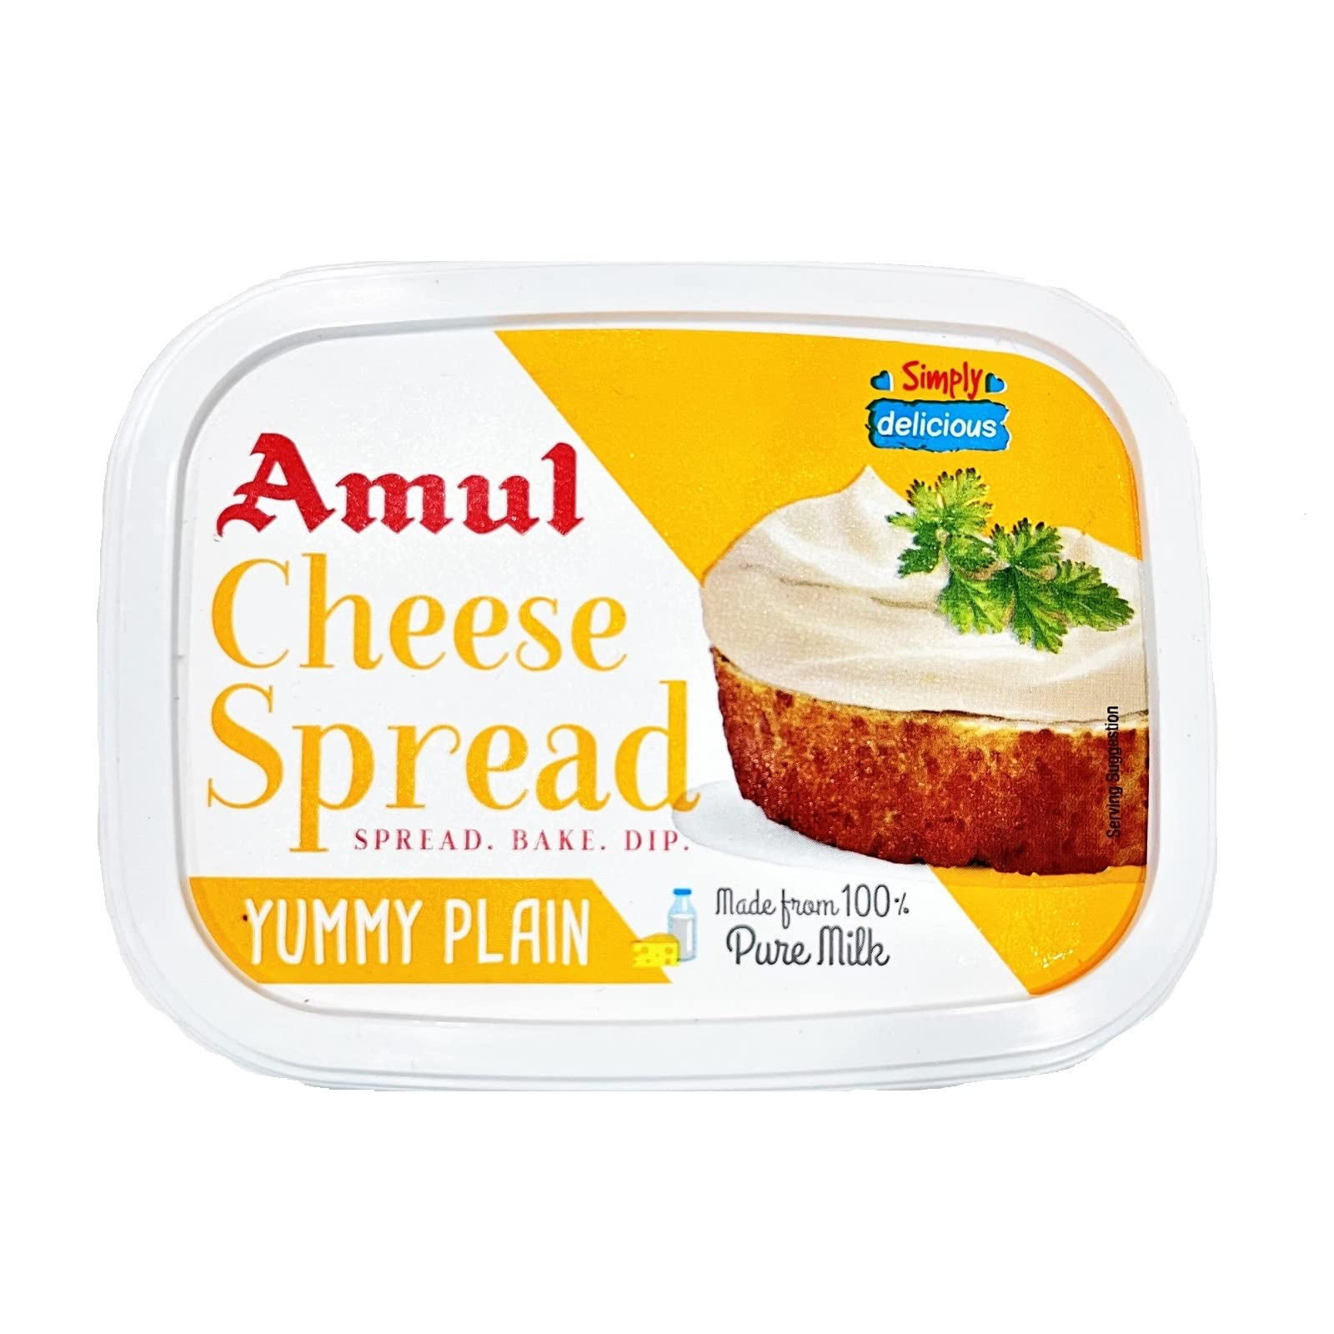
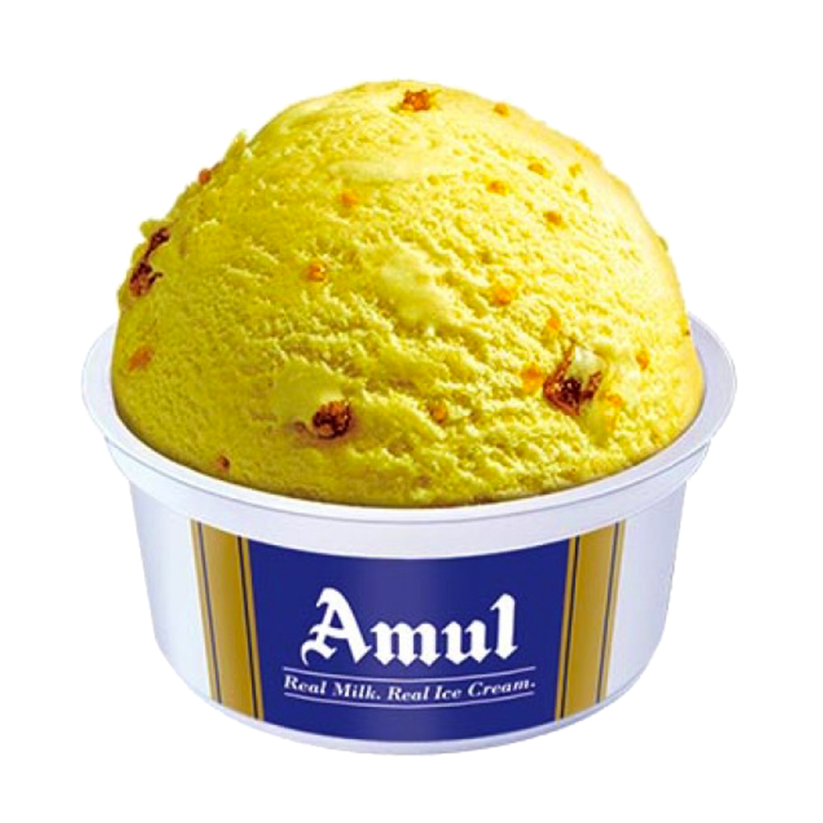
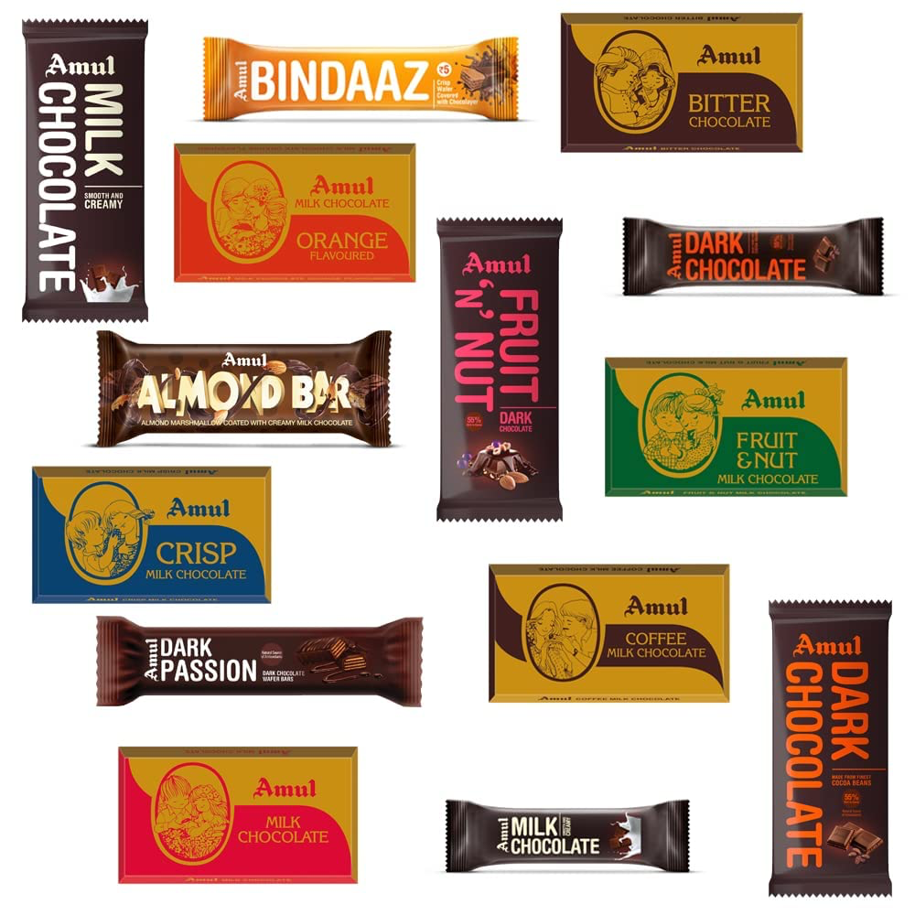
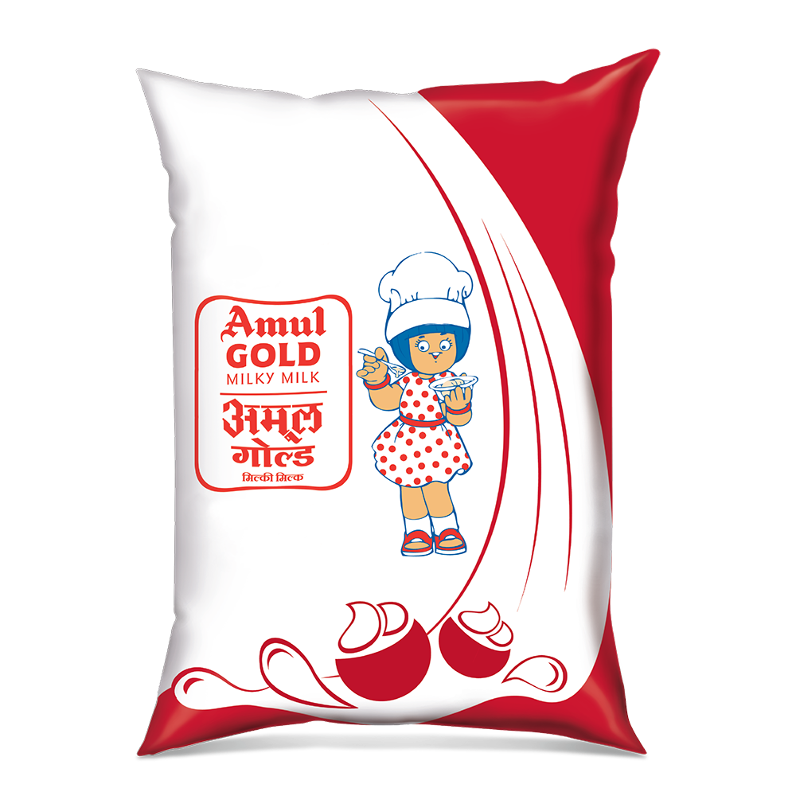
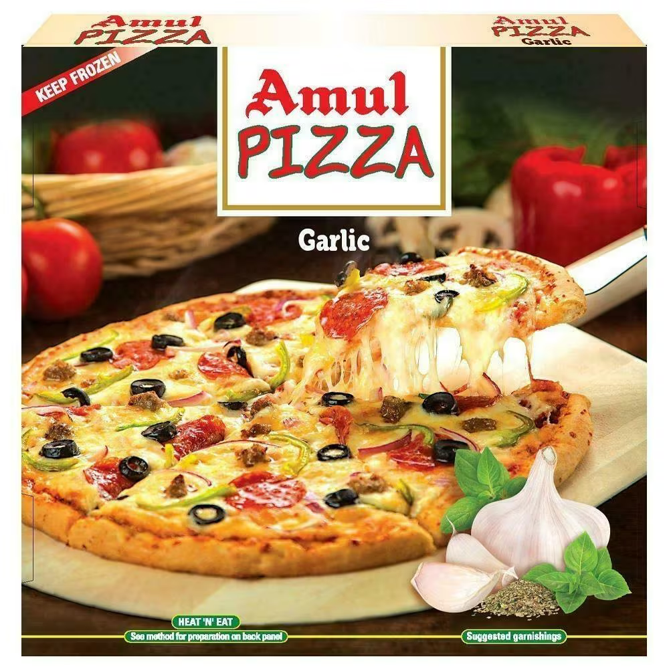
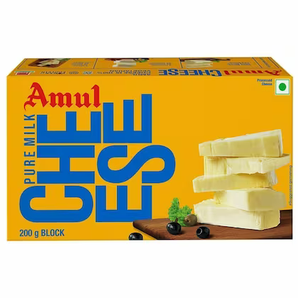
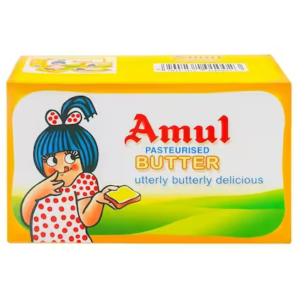
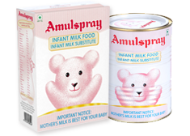
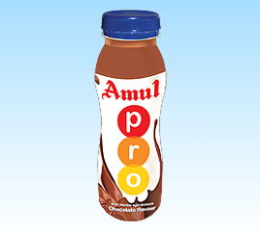
BCG Matrix

Slide 23
PRODUCT DESIGN STRATEGY
Whether to offer standard or customized products."
Amul has offered a mix of both standard and customized products.
Use of Utterly-Butterly Girl:
Using since 1967. Entered in the Guinness Book Of World Records for being the
longest running campaign ever.

Slide 24

Business Strategies
Developing demand
Limited purchasing power, modest consumption level.
A low cost price strategic product.

Slide 25

The distribution network
Dry & cold warehouse.
Cash transaction throughout the supply chain
V JIT improves dealers returns on investments (ROI)

Slide 26
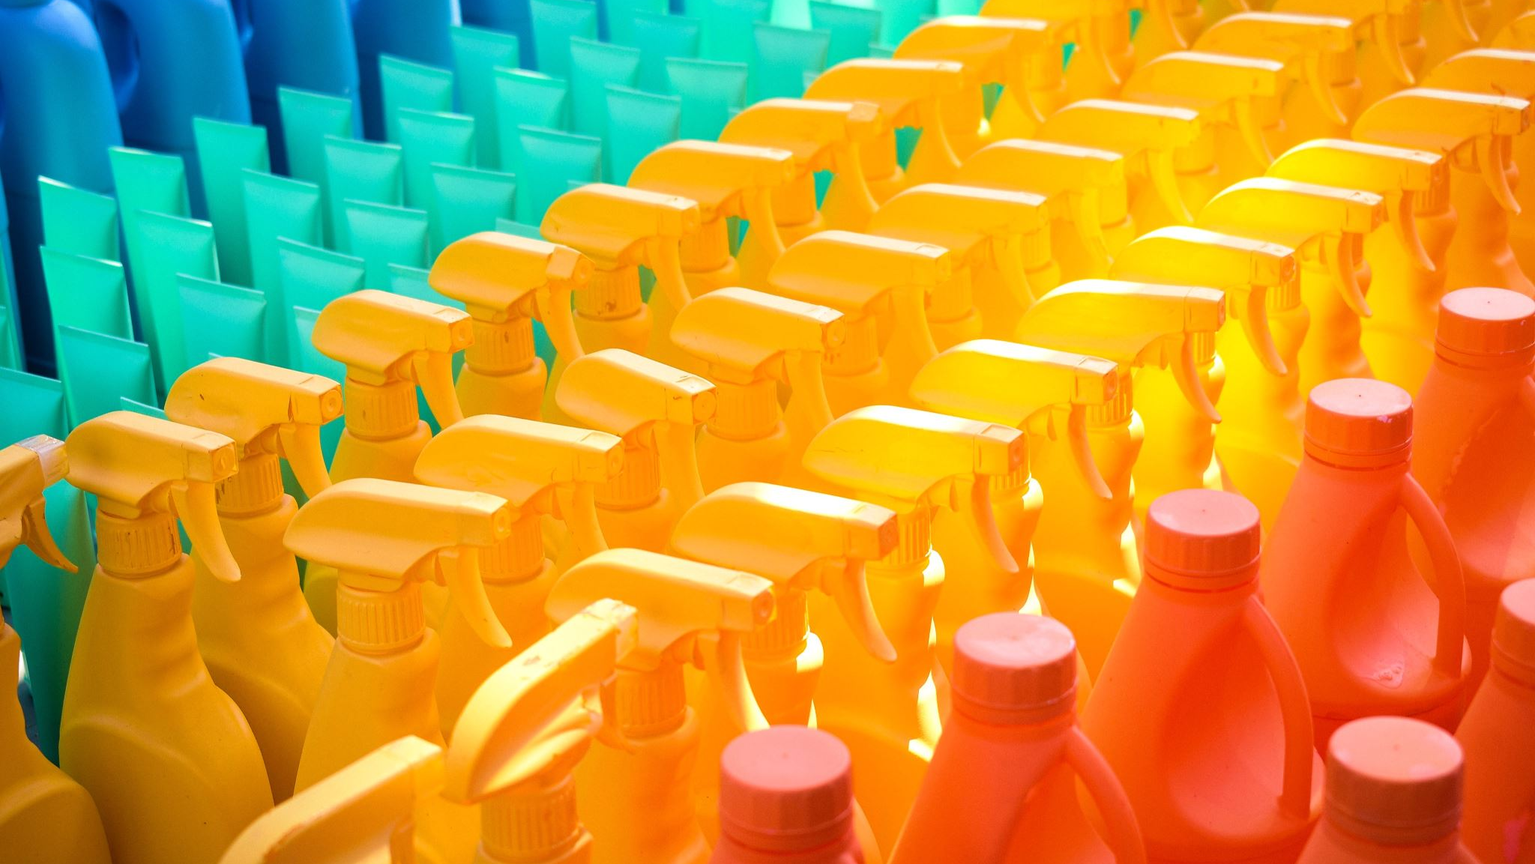
Umbrella brand
Common brand for most product categories Alum's sub-brands, edible oil products - Dhara, mineral water - Jal Dhara
Brand while fruit drinks - Safal

Slide 27

Third-party service provider
Core is milk processing, production of dairy products vlogistics of milk collection, distribution of dairy products,
Sale of products through dealers and retail stores

Slide 28
STRATEGIES OF AMUL
Excellent brand quality.
Excellent quality management.
Good product portfolio.
Strong supply chain.
Rural presence
Avability of raw materials.

Slide 29
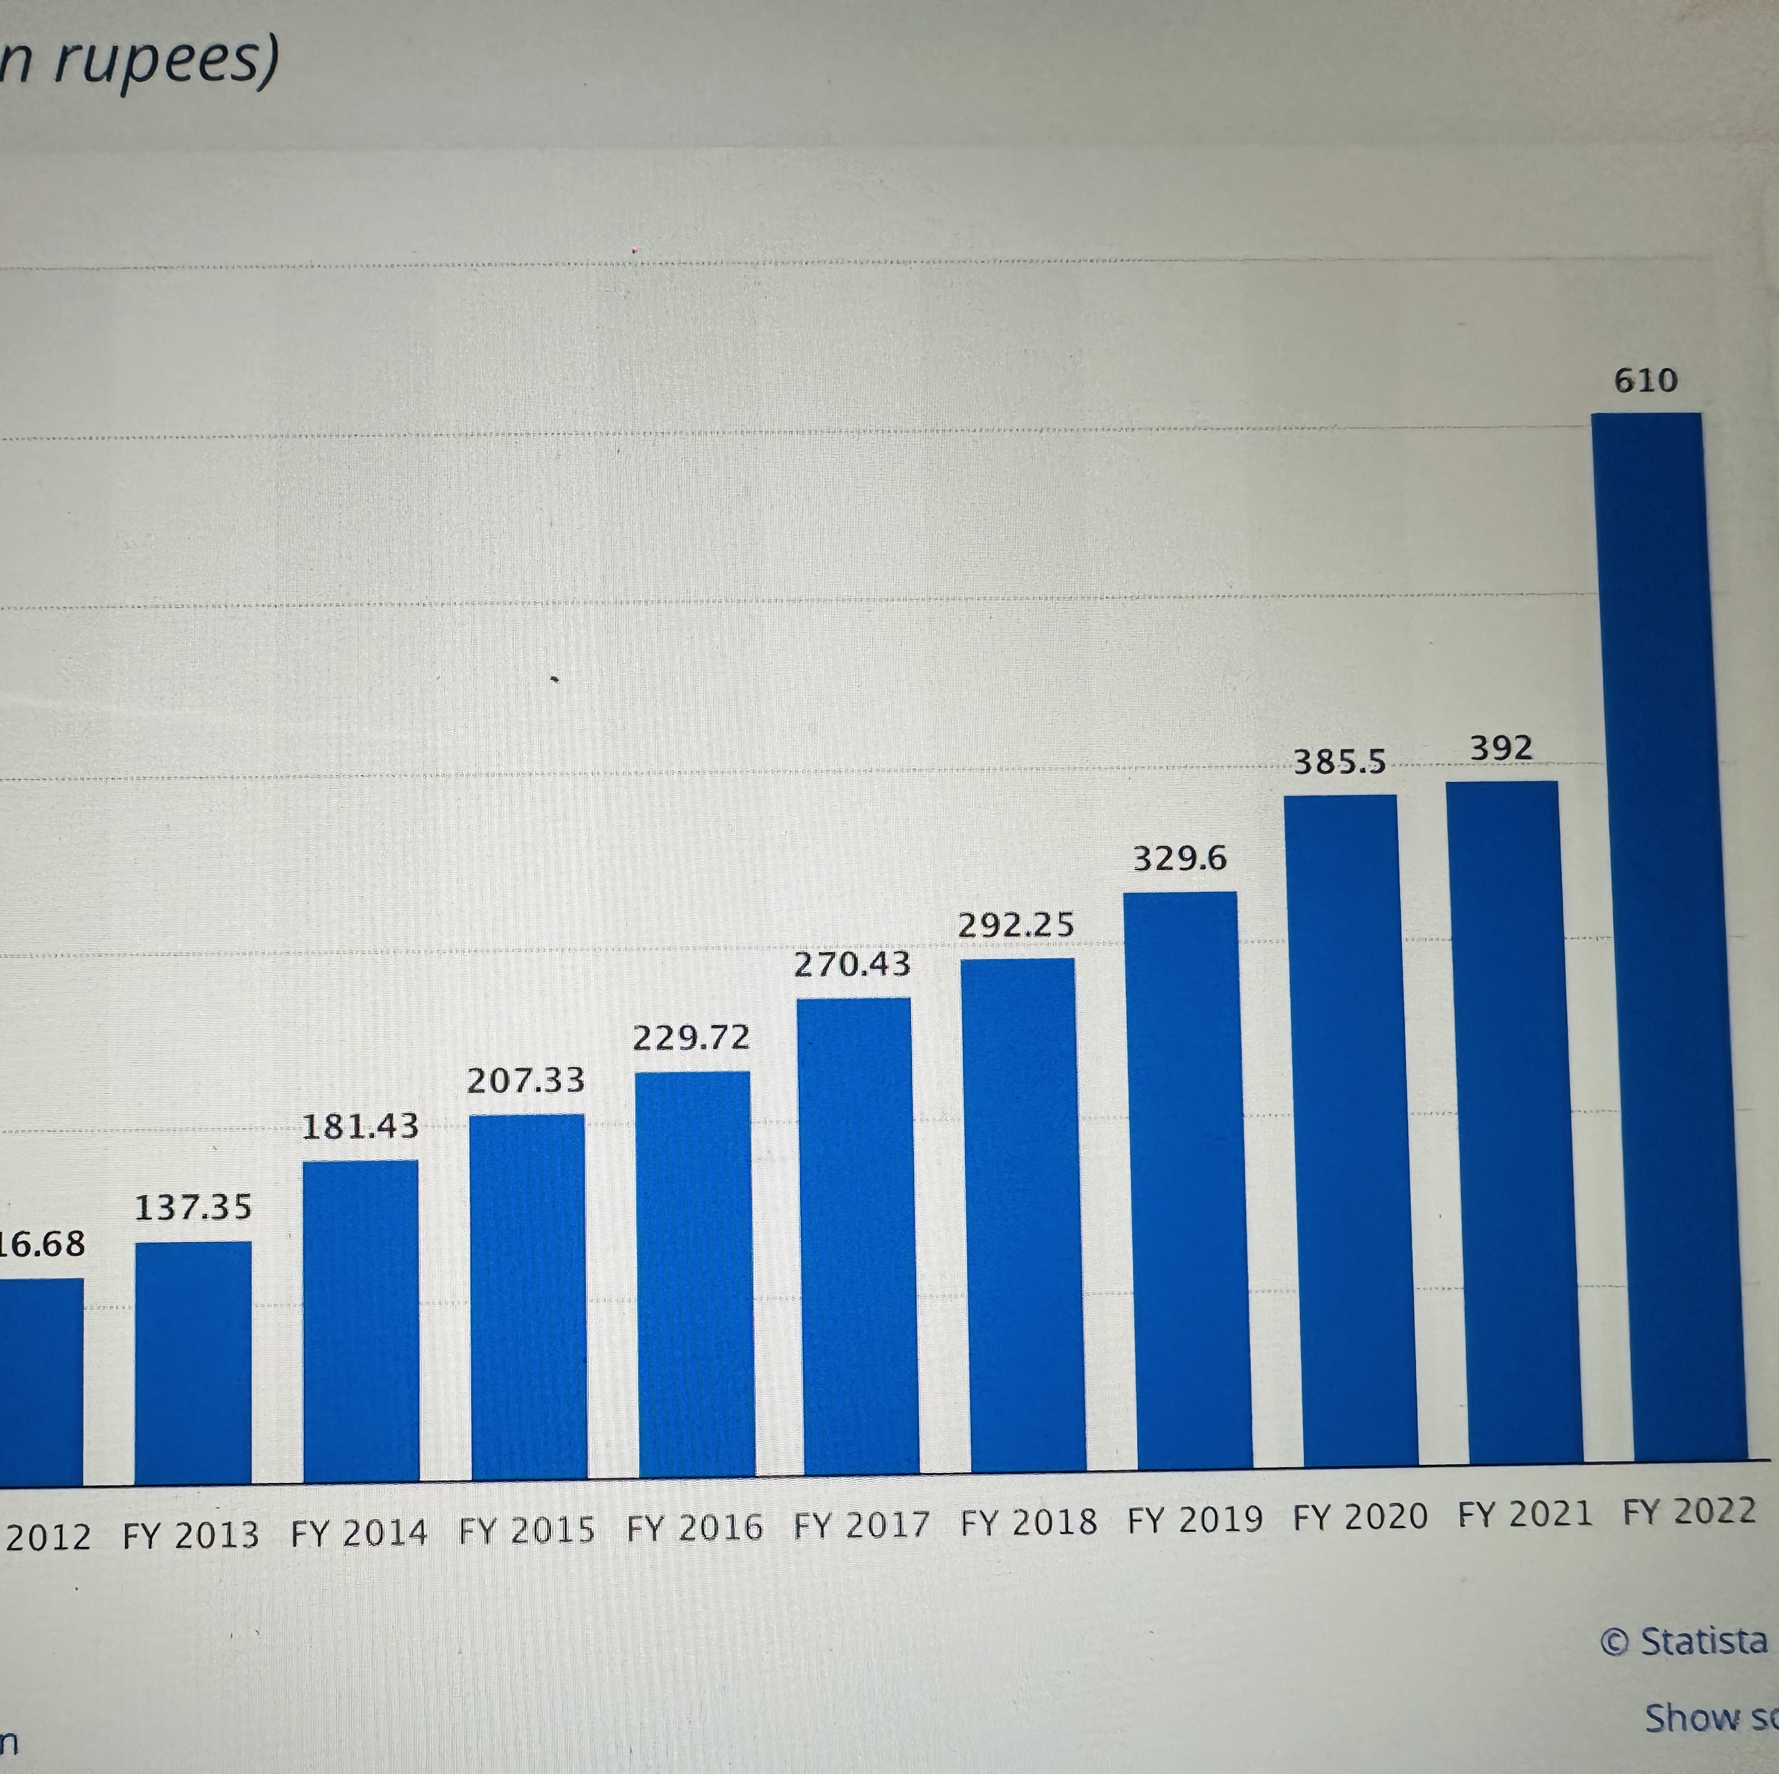
Turnover

Slide 30
Further improvement in AMUL
Amul can venture out on new products like Toned milk, Condensed milk that can be used for sweets, Baby food products,
There are certain product like Amul basundi, gulab jamoon, choclates etc which are not as popular as Amul ice cream. Amul must try to understand the cause of this through thorough market research and work on improving these products.
Though Amul's hoardings are a huge success, it can penetrate even better in the rural areas by advertising through the media viz cable channels and newspapers. Sponsoring shows in TV, sports events can be of great help.

Slide 31

References
http://www.socialsamosa.com/2014/10/amul-customer-complaint-facebook/
https://viden.io/knowledge/the-case-study-of-amul
www.marketing91.com
www.amul.com
www.papers.ssrn.com
www.bigbasket.com
https://www.marketing91.com/marketing-strategy-amul/
https://www.marketing91.com/swot-analysis-amul/
https://brandyuva.in/2018/11/marketing-strategies-of-amul.html
https://www.slideshare.net/rajkumardt/amul-pptpotx
https://www.slideshare.net/kaverinanda/amul-rural-marketing
https://www.mbaskool.com/pestle-analysis/companies/17971-amul.html

